Slide 1

Basic Details of the Team and Problem Statement
Ministry/Organization Name/Student Innovation:
Ministry of Defence
PS Code: SIH1416
Problem Statement Title: AI based Automatic alarm generation and dropping of payload at a particular object through a Drone. Team Name: AeroSolutions Team Leader Name: Bhavin Baldota
Institute Code (AISHE): U-0888
Institute Name: Vishwakarma University
Theme Name: Disaster Management

Slide 2
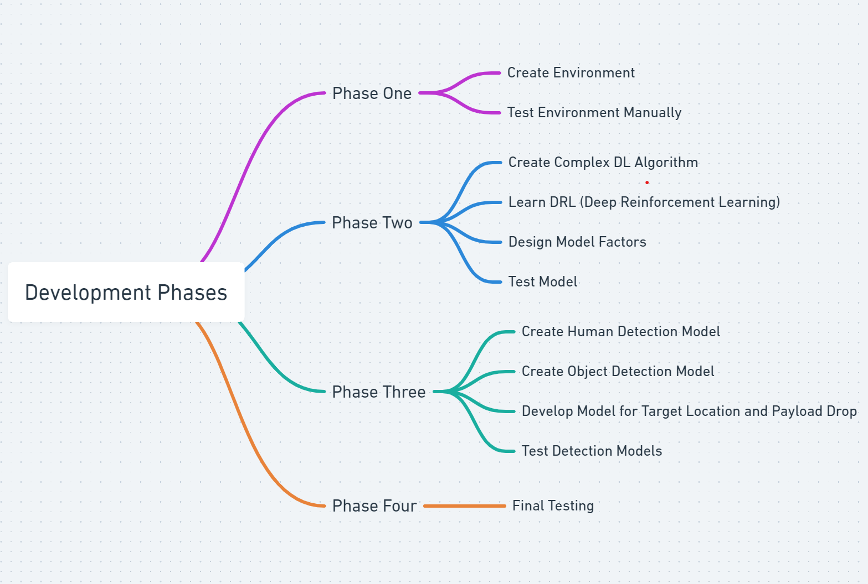
Idea/Approach Details
Solution Overview:
Solution centers on using software and AI to revolutionize disaster response with drones.
Integration of Unity, Deep Reinforcement Learning (DRL), and Deep Learning is key to system development.
System automates drone flight and enhances object recognition capabilities.
Technology is particularly beneficial in critical disaster scenarios like earthquakes and floods.
Specialized in detecting humans from altitudes of 50-100 meters, even at slanted angles.
Enables precise and targeted aid delivery through payload drops.
Represents a significant advancement in leveraging technology to save lives and reduce disaster impact.
Technology stack:
Drone Technology
Cameras
Artificial Neural Network or AI Hardware/Software
Payload Dropping Mechanism
Unity
Deep Reinforcement Learning (DRL)
Deep Learning
Raspberry Pi

Slide 3
Idea/Approach Details
Use Cases:
Dependencies/Show Stoppers:
Disaster Response: Our software-centric solution plays a crucial role in disaster response scenarios, where rapid and accurate assistance is required. By automating drone flight and object recognition, we can provide immediate support during events like earthquakes and floods.
Automatic Object Recognition: The system excels in recognizing and categorizing objects, particularly human beings, from a drone's perspective, even in challenging conditions.
Payload Dropping: Once objects are identified, our software enables precise payload drops, which can include essential supplies like food, clothing, and rescue tools near the detected individuals.
Technical Challenges: Our solution faces several technical challenges, such as optimizing drone flight paths, fine-tuning the DRL algorithms, and ensuring accurate object detection in varying environmental conditions.
Hardware/Software Dependencies: We rely on a combination of software and hardware components, including Unity, DRL frameworks, deep learning libraries, Raspberry Pi, and drone hardware. Ensuring seamless integration and compatibility among these elements is critical to success.
Regulatory Compliance: Adhering to regulatory and safety standards for drone operations is paramount, and we must address compliance issues during development and deployment.

Slide 4
Team Member Details
Team Leader Name: Bhavin Baldota
Branch: Btech Stream: Artificial Intelligence and Data Science Year: III
Team Member 1 Name: Darshit Mehta
Branch: Btech Stream: Computer Science Year: III
Team Member 2 Name: Atharv Talathi
Branch: Btech Stream: Computer Science Year: III
Team Member 3 Name: Anuja Badve
Branch: Btech Stream: Computer Science Year: III
Team Member 4 Name: Dhruv Dhabalia
Branch: Btech Stream: Artificial Intelligence and Data Science Year: III
Team Member 5 Name: Havi Agarwal
Branch: Btech Stream: Artificial Intelligence and Data Science Year: III

